Slide 1
Analog Communications
Signals and Communication Systems (24EC2105)

Slide 2
Angle Modulation

Slide 3

Angle Modulation
The phase angle of the carrier wave is varied in accordance with the amplitude of modulating signal is referred to as ‘Angle Modulation’.
PM: The phase of carrier wave is varied in accordance with the amplitude of message signal.
FM: The frequency of the carrier wave is varied in
accordance with the amplitude of the
modulating signal

Slide 4




Phase angle and Instantaneous Frequency
Then the instantaneous frequency

Slide 5
Phase Modulation

Slide 6
Phase Modulation
The phase of carrier wave is varied in accordance with the amplitude of message signal. Assume
Where Kp is phase modulation sensitivity constant.
Then the resulting Phase Modulated wave is
In this case the instantaneous angular frequency is given by
Hence in PM the instantaneous angular frequency varies linearly with the derivative of the modulating signal.

Slide 7
Frequency Modulation

Slide 8
Frequency Modulation
The frequency of carrier wave is varied in accordance with the amplitude of message signal.
The instantaneous angular frequency is given by
or
where is frequency modulation sensitivity constant
Then the resulting Frequency Modulated wave is

Slide 9
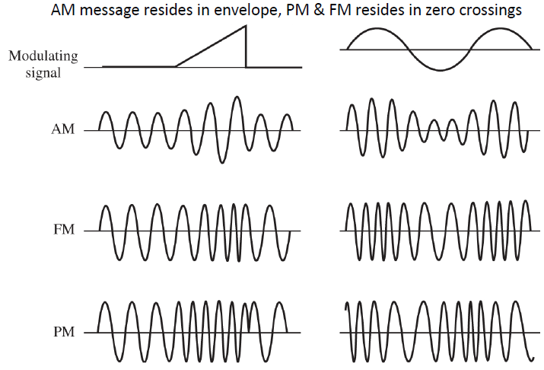
AM, PM and FM Waveforms

Slide 10
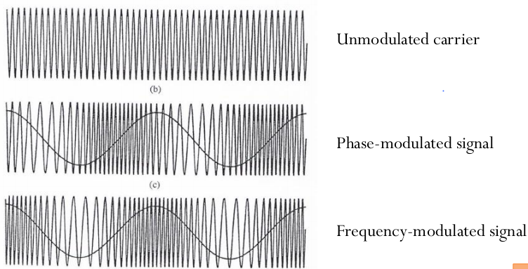
PM and FM Waveforms

Slide 11
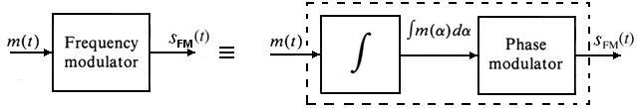
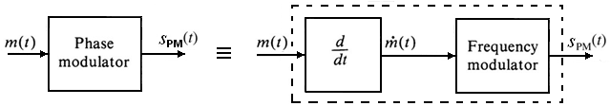
Relationship between PM and FM
Equations and show that in both PM and FM, the angle of a carrier is varied in proportion to some measure of m(t).
In PM : Directly proportional to m(t)
In FM : Directly proportional to integral of m(t)

Slide 12
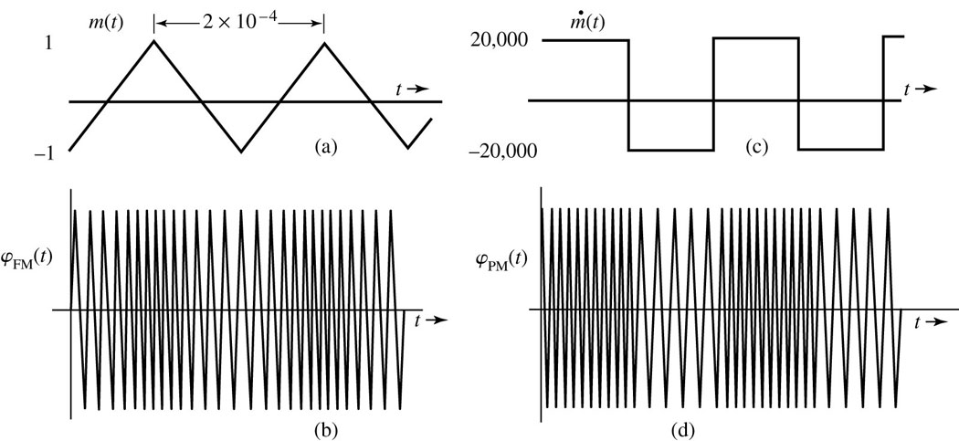
Example1

Slide 13
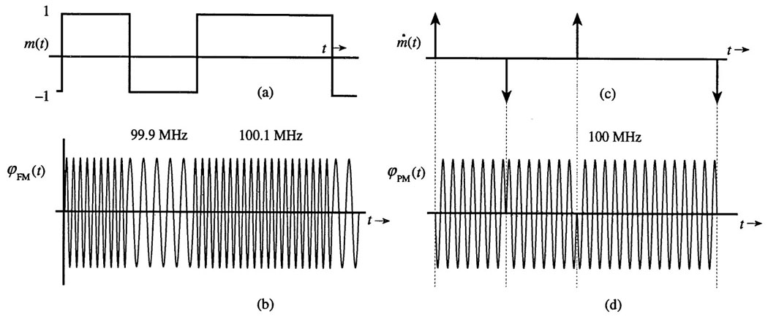
Example 2

Slide 14
END

